Slide 1
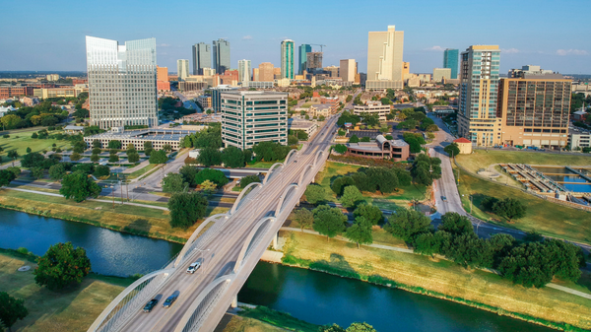
NRC State Agreement & Liaison Programs Branch
Brian Anderson
August 16, 2022

Slide 3
Since August 2021:
13 IMPEP reviews
51 regulation & legislation reviews
568 attendees completed training

Slide 5
Expansion Of Agreement States
Sharing IMPEP Experience
Working Together In The New Normal

Slide 7
Training & Travel – Karen Meyer AStrainingandtravel.Resource@nrc.gov
Regulation Reviews – Michelle Beardsley AgreementStateRegs.Resource@nrc.gov
IMPEP – Robert Johnson Robert.Johnson@nrc.gov

Slide 8
NRC State Agreement & Liaison Programs Branch
Huda Akhavannik – Huda.Akhavannik@nrc.gov
Brian Anderson – Brian.Anderson@nrc.gov
Michelle Beardsley – Michelle.Beardsley@nrc.gov
Robert Johnson – Robert.Johnson@nrc.gov
Taylor Lamb – Taylor.Lamb@nrc.gov
Jeff Lynch – Jeffery.Lynch@nrc.gov
Karen Meyer – Karen.Meyer@nrc.gov
Kathy Modes – Kathy.Modes@nrc.gov
Joe O'Hara – Joe.O'Hara@nrc.gov
Steve Poy – Stephen.Poy@nrc.gov
Elaine Raphael – Elaine.Raphael@nrc.gov
Duncan White – Duncan.White@nrc.gov

Slide 9
Thank You

