Slide 1
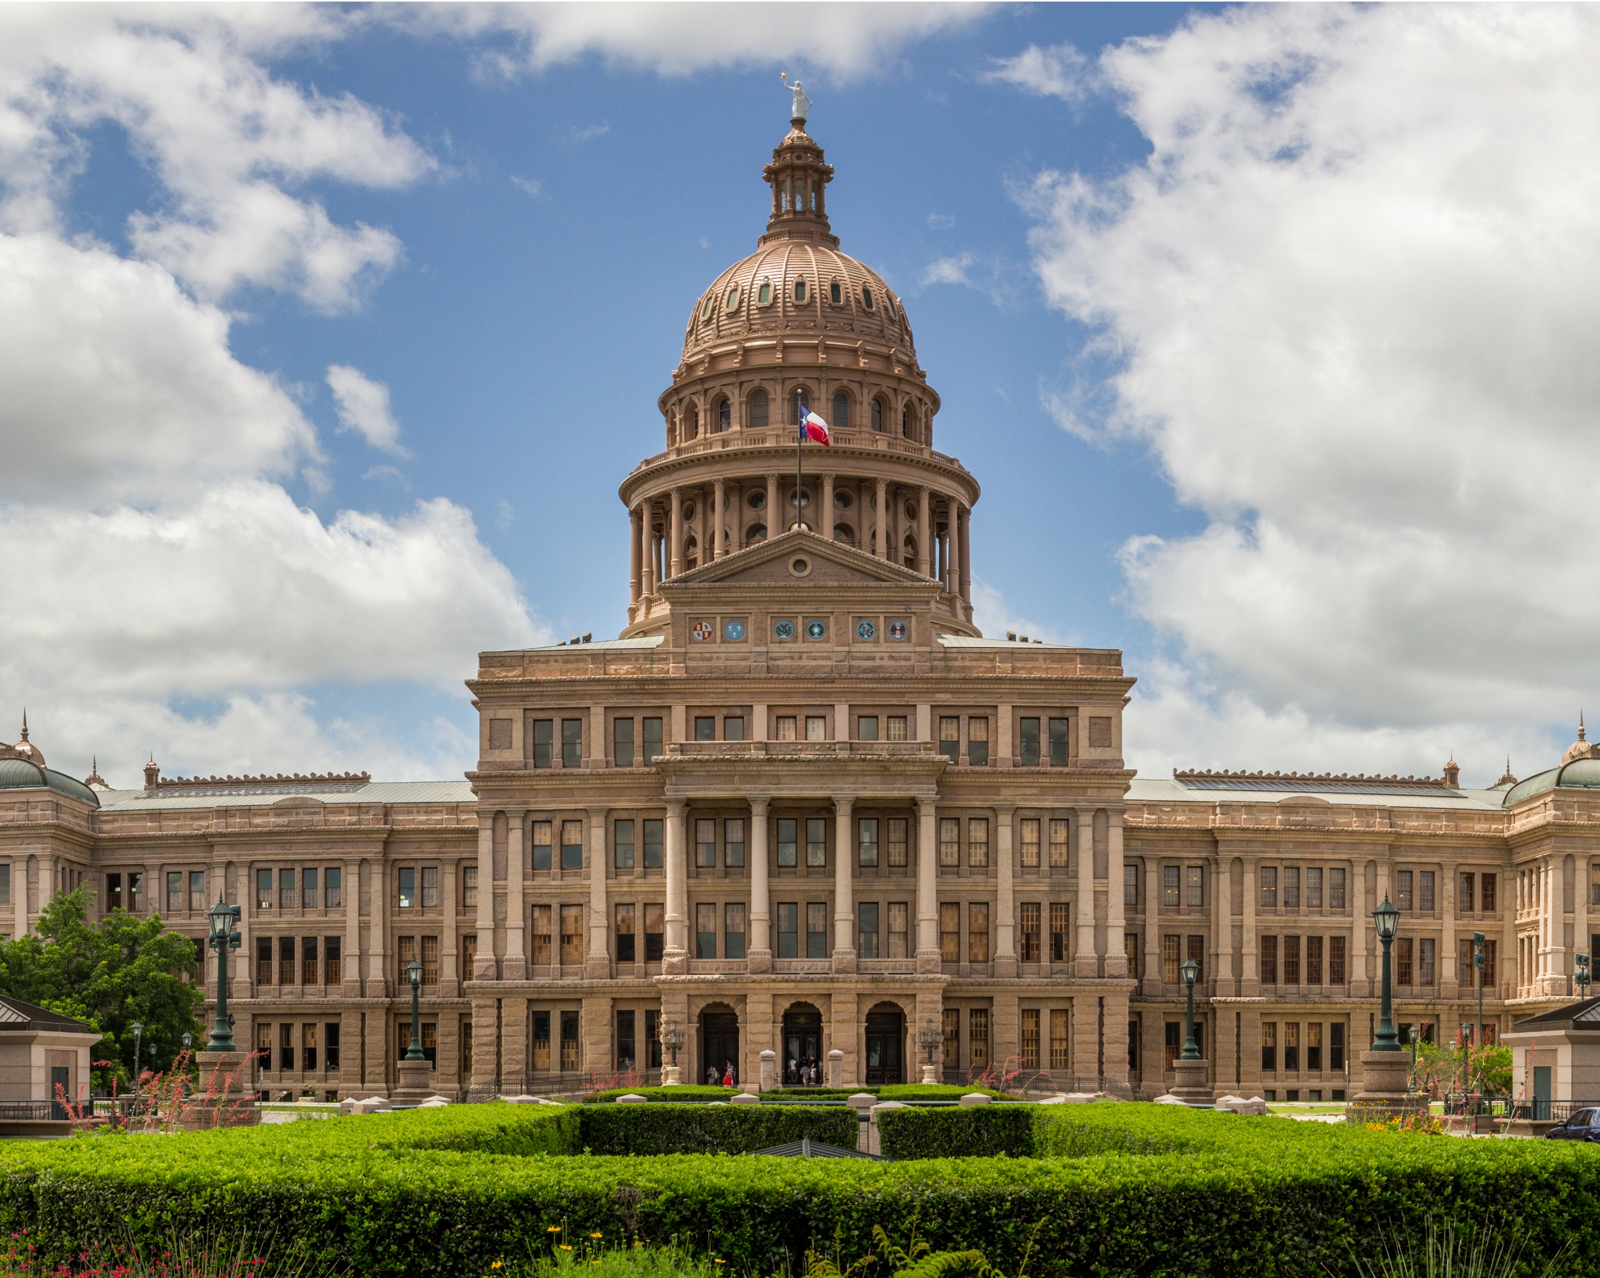
Welcome to Texas!
Texas Department
of State Health Services
Lisa Bruedigan
Director
Radiation Section
Texas Capitol: The capitol and seat of government of the American state of Texas. Located in downtown Austin, Texas,
the structure houses the offices and chambers of the Texas Legislature and of the Governor of Texas.
Notes:
Largest state capital in the country
Texas means Friends in the Caddo Indians language

Slide 2
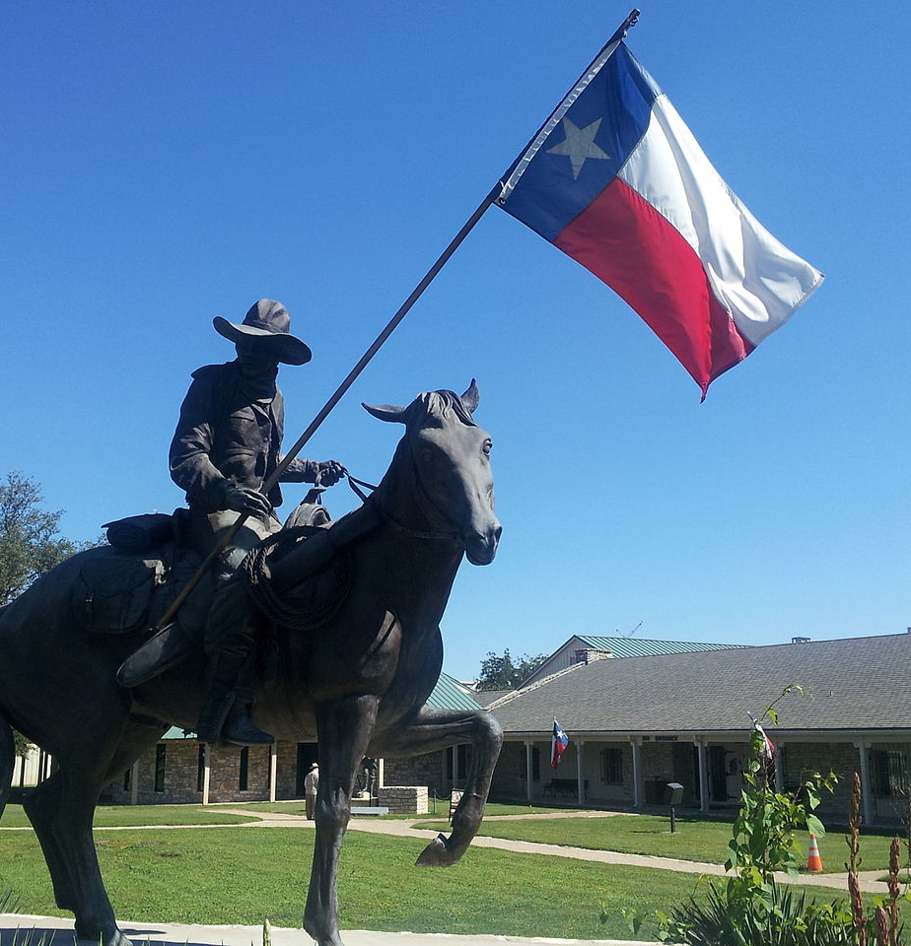
Radiation Control Across Texas
Texas Department of State Health Services
Regulates the use and possession of radiation
Texas Commission on Environmental Quality
Regulates disposal of radioactive material
Texas Railroad Commission
Naturally Occurring Radioactive Material (NORM)
Radioactive materials
X-ray
Mammography
Lasers
Uranium
Byproduct waste
Waste processing
This Photo by Unknown Author is licensed under CC BY-SA
Texas Rangers: Set up by Stephen F. Austin to protect colonists who settled in the Texas Region in the 1800’s. The Texas Rangers are still in operation today, conducting major violent crime, public corruption, cold case and officer involved shooting investigations. The also oversee the border security and tactical and crisis negotiation programs.
Notes:
Agreement State in 1963

Slide 3
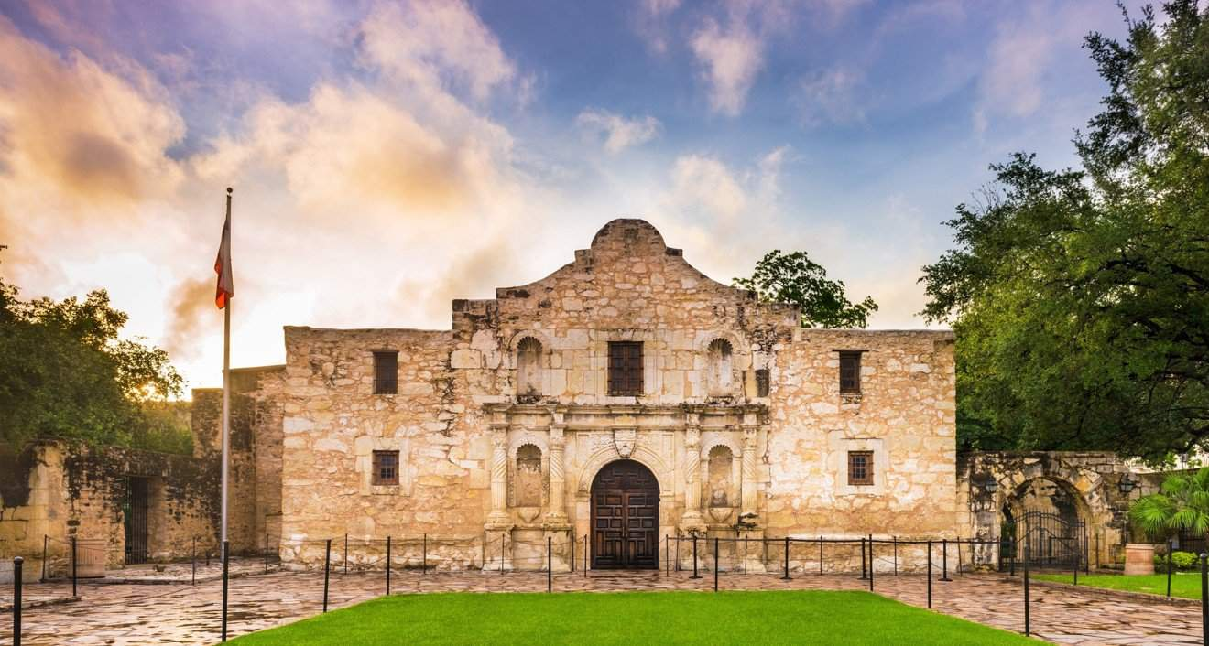
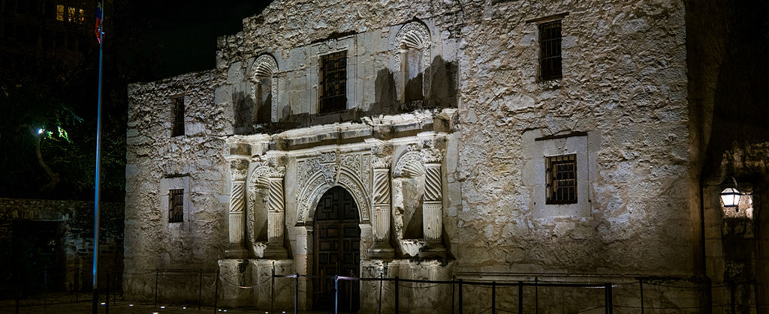
Texas Commission on Environmental Quality
Regulates and licenses:
Disposal of radioactive substances
Processing of:
Low level radioactive waste (LLRW)
Naturally occurring radioactive material (NORM)
By-product material
Recovery & processing of source material
Processing of by-product material
Sites for storage & disposal of LLRW, by-product & NORM
This Photo by Unknown Author is licensed under CC BY-NC-ND
The Alamo: an historic Spanish mission that was the site of the Battle of the Alamo in 1836.
This Photo by Unknown Author is licensed under CC BY-SA

Slide 4
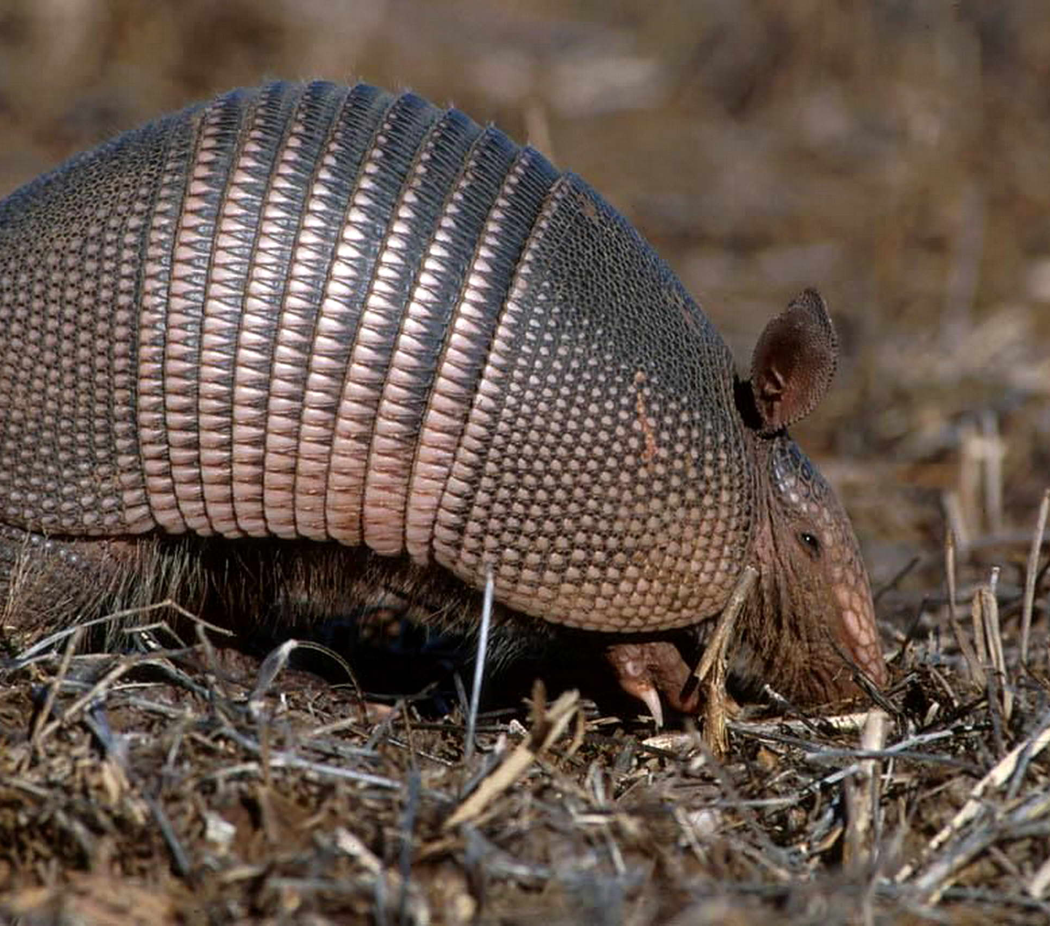
TCEQ Radioactive Materials Section
Regulates licensing of uranium recovery operations
Technical staff:
Health Physicists – 4
Engineers – 4
Geoscientists – 2
Uranium deposits are found naturally in south Texas
Industrial
Nuclear power generation
Armadillo-mania is contagious in the Lone Star State, as Texans, for no apparent reason, have adopted this armor-plated critter as their mascot. Affection for the near-sighted rooter has reached the faddish level as decals, games, puzzles, candles, stuffed toys, figurines, jewelry, T-shirts, and other items are decorated with or shaped to resemble armadillos.
And what about the creature that has caused this strange cult of armadillo lovers – a less likely mammal could hardly be found. It isn't even cuddly. Some observers, who have not fallen under the armadillo's spell, have been so unkind as to call it ugly.

Slide 5
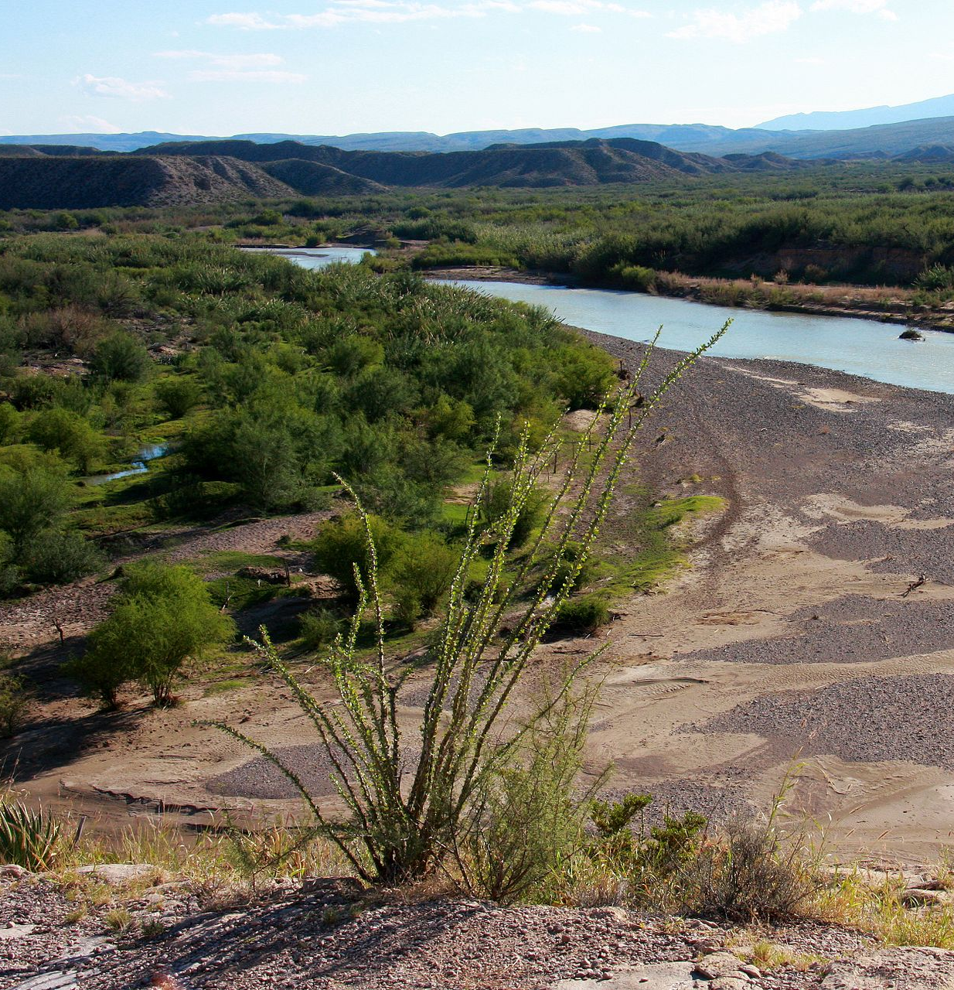
TCEQ Radioactive Materials Compliance Program - Critical Infrastructure Division
Focuses on safety & security of material and waste
Health Physicist Investigators – 3
Inspections & investigations
Uranium mining/recovery
Waste processing/storage
Radioactive by-product handling/disposal
LLW disposal
Underground Injection Control Permit sites
Members of State Emergency Response Team
The Rio Grande is one of the principal rivers (along with the Colorado River) in the southwestern United States and in northern Mexico. After traversing the length of New Mexico, the Rio Grande becomes the Mexico–United States border, between the U.S. state of Texas and the northern Mexican states of Chihuahua and Coahuila, Nuevo León and Tamaulipas;

Slide 6
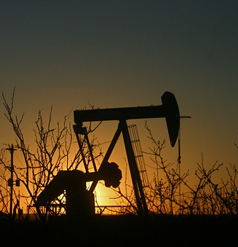
TCEQ Resident Inspectors
Assigned to Waste Control Specialists – Andrews, TX
Low-level waste disposal
Conduct inspections:
LLW
By-product disposal
Material storage & processing
Serve as State Agents for receipt of TX compact waste and owner control of the TX compact waste
https://www.tceq.texas.gov/
This Photo by Unknown Author is licensed under CC BY-NC-ND
The Permian Basin and Oil: A large sedimentary basin in the southwestern part of the United States. It is the largest petroleum producing basin in the United States!
Notes:
Produce 40% of the nations oil & 25% of the natural gas

Slide 7
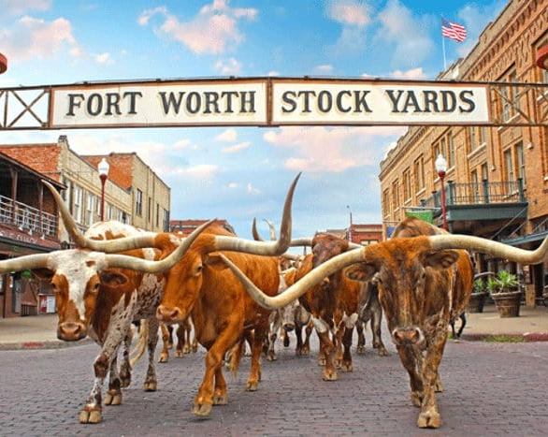
Texas Railroad Commission
The Fort Worth Stockyards: Historic district in Fort Worth, Texas. In 1876 it was a very important livestock center of the area. Today, it celebrates the long tradition of the cattle industry.
RRC
Jurisdiction over oil and gas NORM disposal
Currently no permitted commercial landfills or disposal pits authorized for NORM disposal
DSHS regulates NORM
Recycling
Decontamination of equipment
Possession of use, transfer, transport & storage unless at disposal site
https://www.rrc.texas.gov/
This Photo by Unknown Author is licensed under CC BY-NC-ND

Slide 8
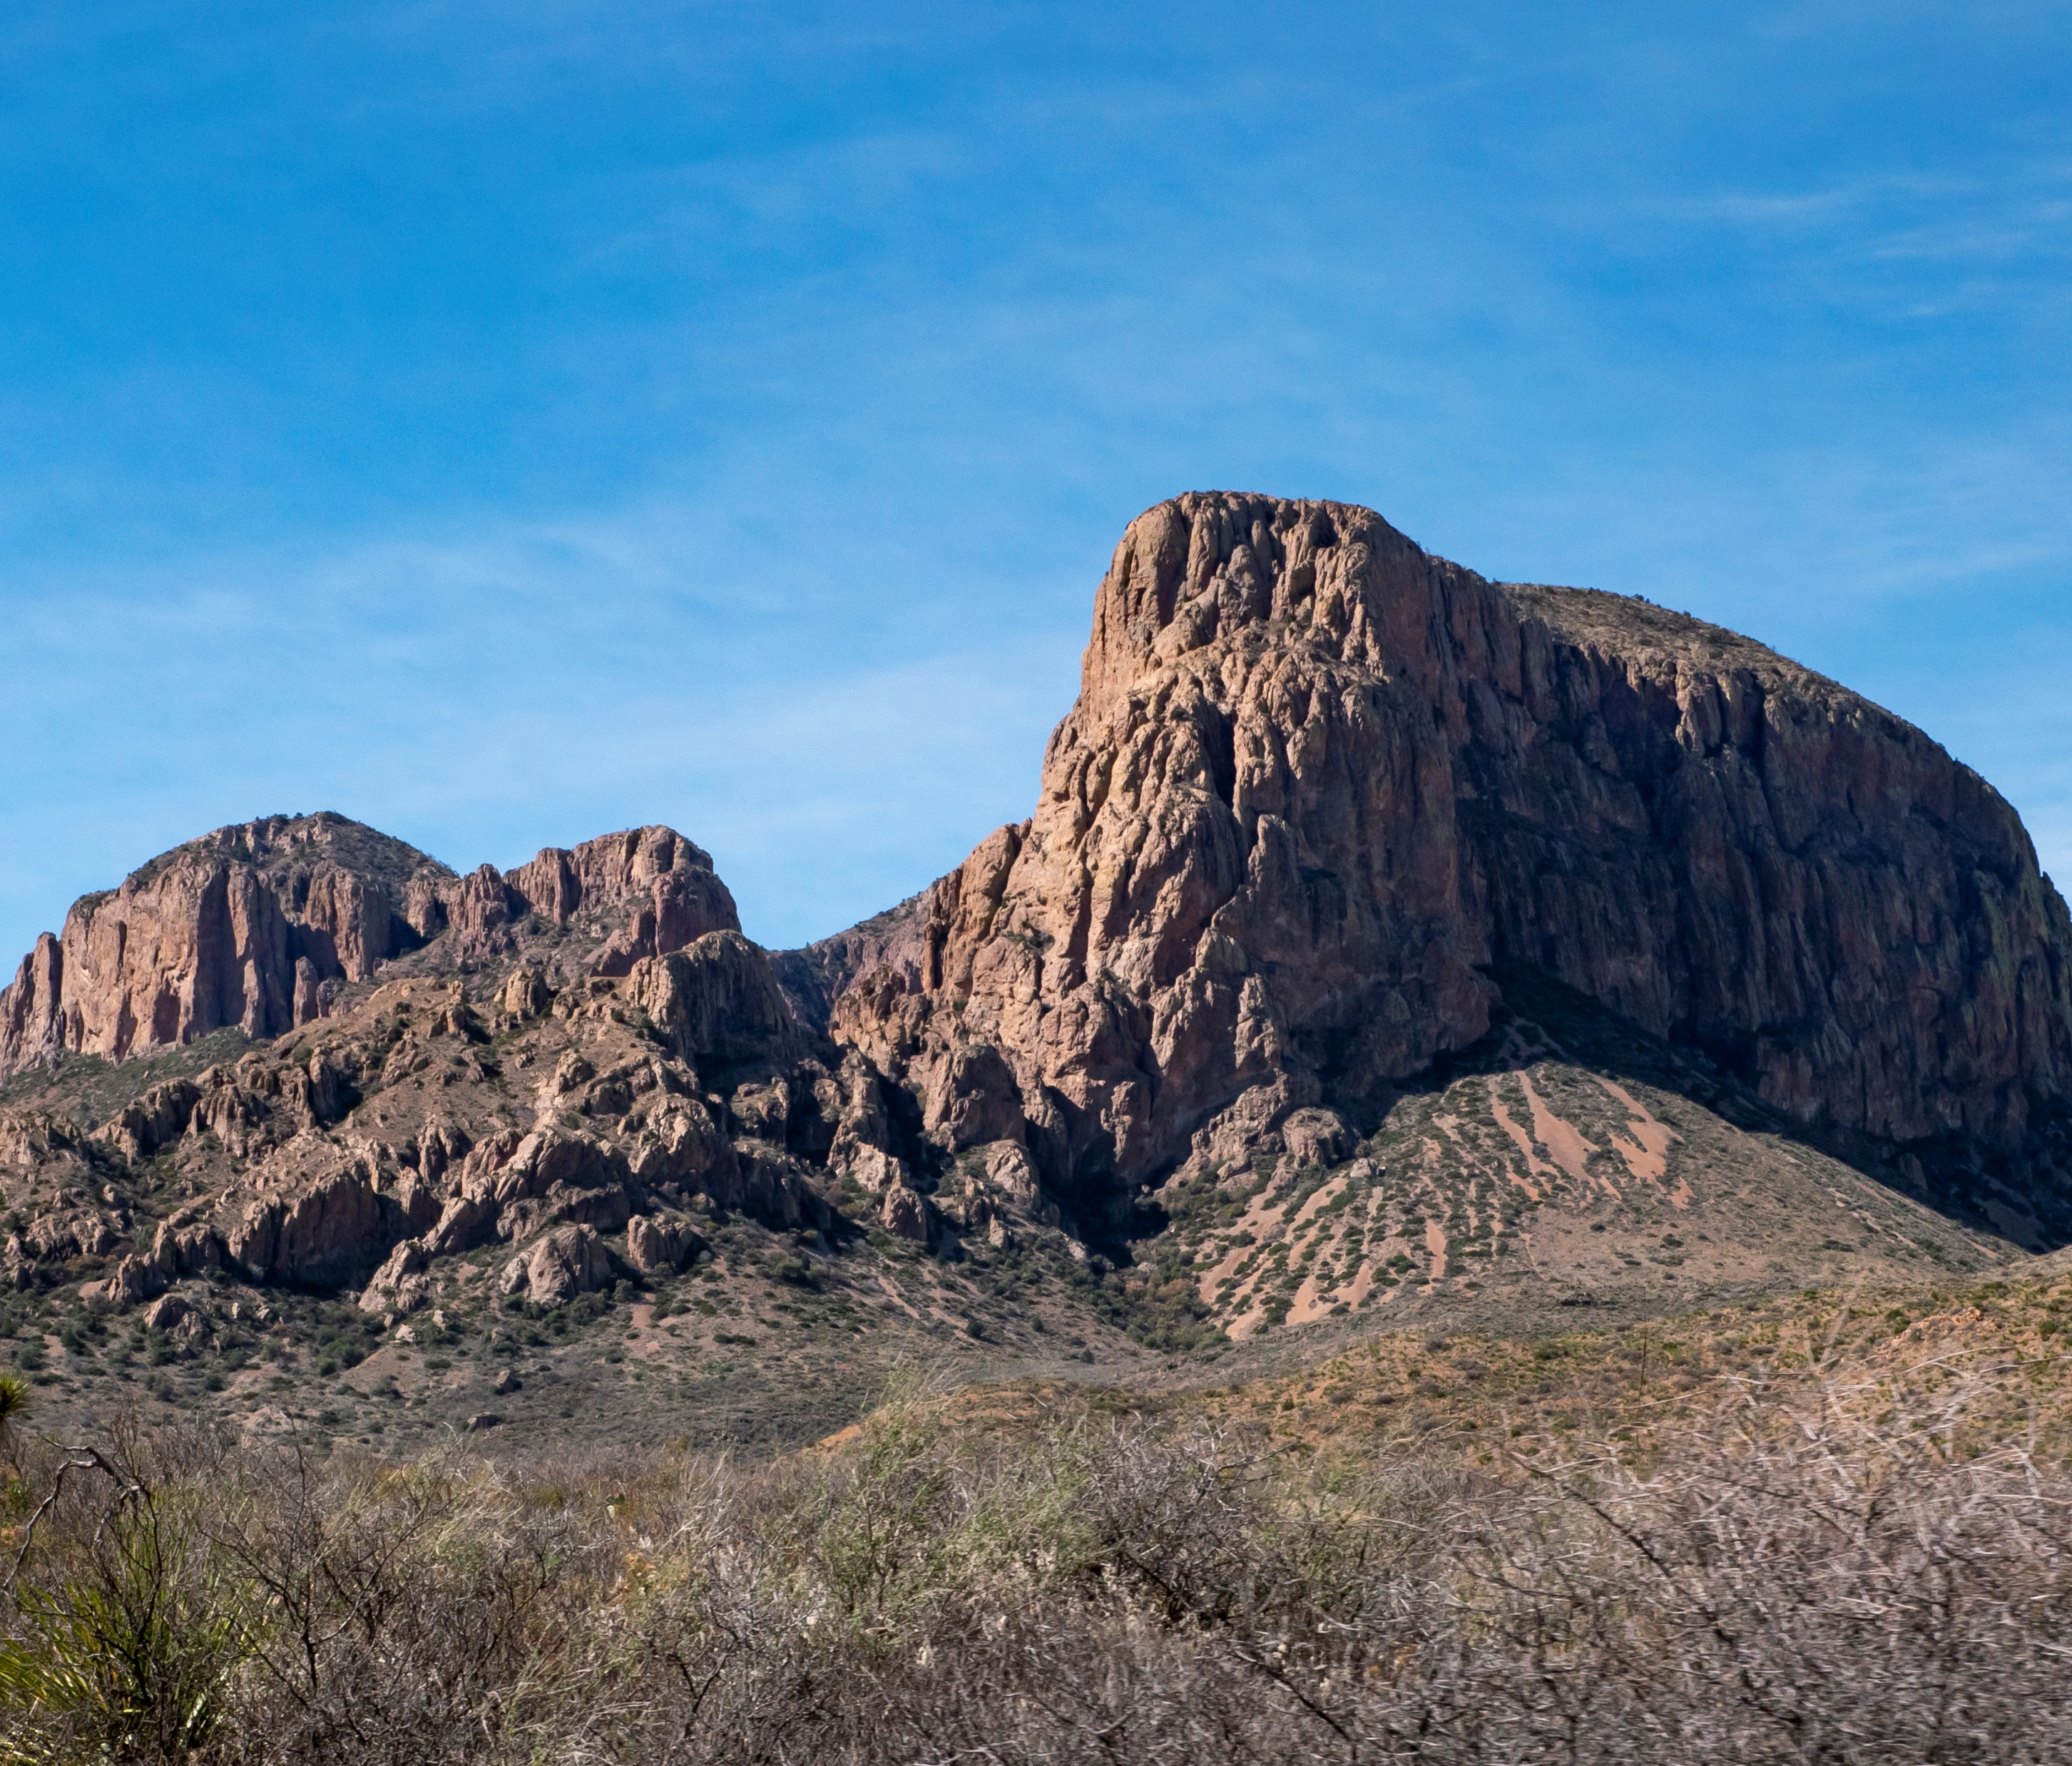
A Big Neighborhood
254 counties
268,596 square miles
801 miles long
773 miles wide
Big Bend National Park: A desert park encompassing the largest protected area of the Chihuahuan Desert. It is the only park in the United States that contains a complete mountain range – the Chisos.
Notes:
12 to 15 hours to drive across or from end to end

Slide 9
Department of State Health Services Realignment
2004
Organized by functional silos
Inspections
Business Filing and Verification
Policy Standards & Quality Assurance
Compliance
Feb. 2022
Function like a bureau
Streamlined decision making
Allows for staff efficiencies
This Photo by Unknown Author is licensed under CC BY-SA
Texas Rangers: Set up by Stephen F. Austin to protect colonists who settled in the Texas Region in the 1800’s. The Texas Rangers are still in operation today, conducting major violent crime, public corruption, cold case and officer involved shooting investigations. The also oversee the border security and tactical and crisis negotiation programs.

Slide 10
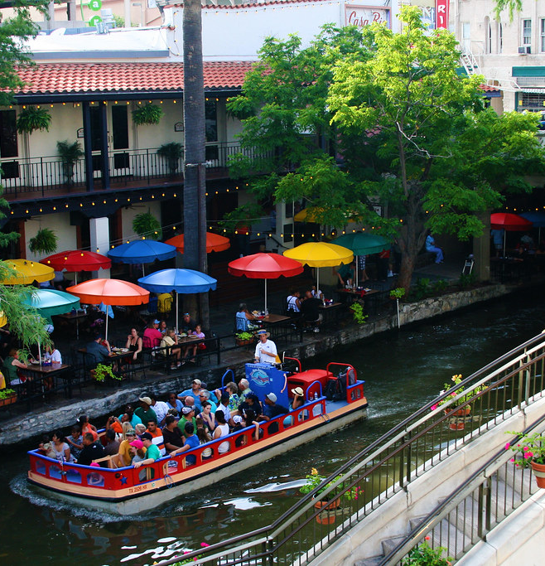
DSHS Diverse Program of 120 Staff Members
Radioactive Materials: 37
Inspections - 14
Licensing - 11
Compliance Reviewers – 2
Compliance Specialist - 1
Rule Writers - 1
Incident Investigations - 5
Emergency Response Planners – 3
X-ray, Mammo & Laser - 83
This Photo by Unknown Author is licensed under CC BY
San Antonio Riverwalk: One of the most visited places in all of Texas and the heart of the San Antonio area.

Slide 11
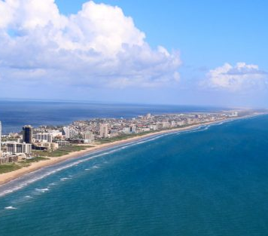
DSHS Inspectors Across Texas
This Photo by Unknown Author is licensed under CC BY-NC-ND
South Padre Island: A barrier island offers a taste of the tropics on the coast of Texas

Slide 12
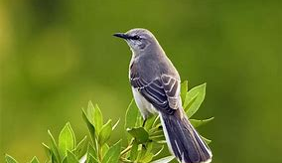
DSHS Workload
Licensees:
RAM – 1,581
SSD - 37
X-ray & Laser -21,266
Mammo- 614
Activities x last 4 years:
5,969 licensing actions
3281 RAM inspections
202 RAM incidents
www.dshs.texas.gov/radiation/
Mockingbird: State Bird of Texas

Slide 13
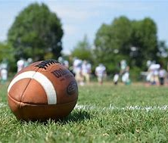
Industrial Radiographer Certification Program
3600 active IR certifications in TX
Partnership with CRCPD to provide the IR examinations as part of the national IR certification program.
Switched to computer-based testing in 2020.
Average 1,500 exams/year
Texas is home to some of the country’s top college football programs. For the state’s best, they serve as a gateway to the NFL. The love of football starts as early as high school with the tradition of Friday night football games!

Slide 14
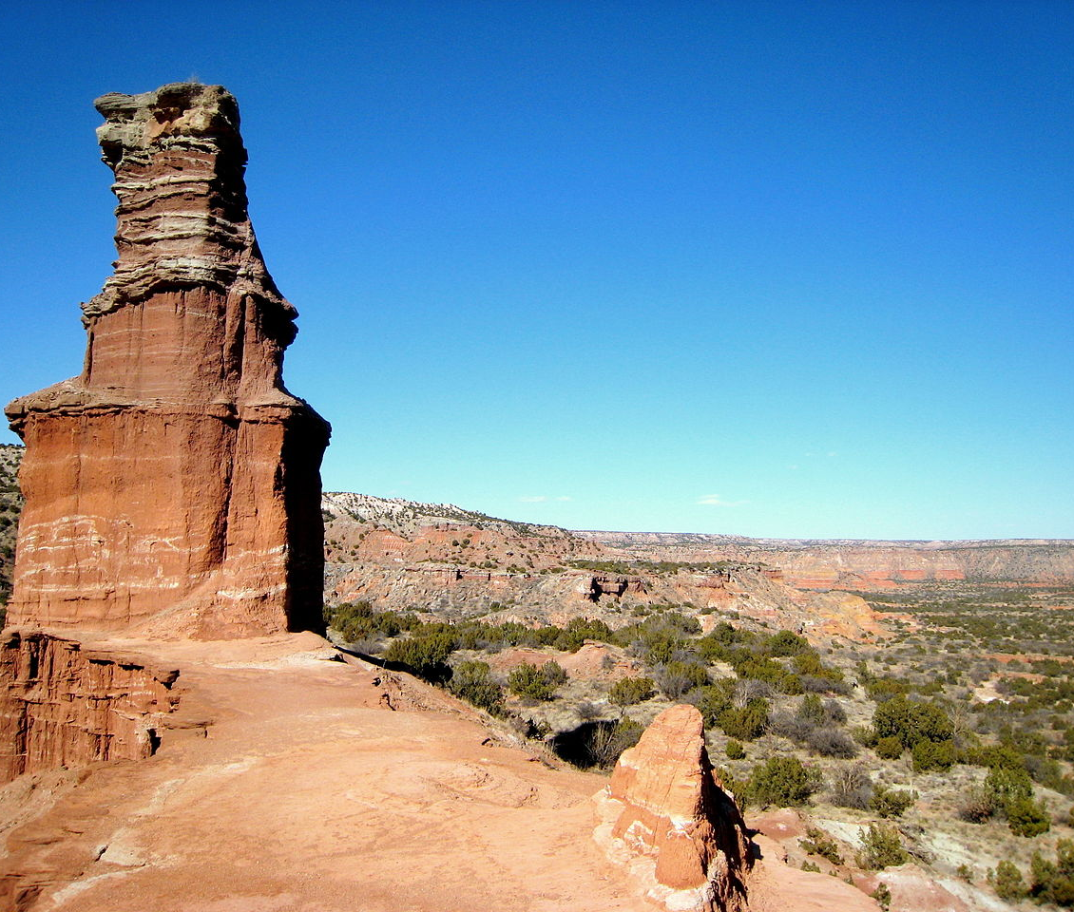
Compliance Actions
Radioactive Material Cases | FY 2017 | FY 2018 | FY 2019 | FY 2020 | FY 2021 | FY 2022 (YTD) | Average
No. of Cases | 34 | 45 | 34 | 29 | 49 | 44 | 39
Cases Closed with an Order | 36 | 41 | 40 | 30 | 42 | 38 | 38
Administrative Penalties Assessed | $102,125 | $164,500 | $116,438 | $122,265 | $129,900 | $131,475 | $127,784
Revocations | 2 | 5 |  | 10 | 2 | 3 | 4
This Photo by Unknown Author is licensed under CC BY-SA
Palo Duro Canyon is a canyon system of the Caprock Escarpment located in the Texas Panhandle near the cities of Amarillo and Canyon. As the second-largest canyon in the United States
Notes:
Countries 2nd largest canyon system

Slide 15
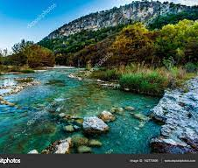
Compliance Actions – Industrial Radiography
Industrial Radiographer Cases | FY 2017 | FY 2018 | FY 2019 | FY2020 | FY 2021 | FY 2022 (YTD) | Average
No. of Cases | 10 | 21 | 16 | 3 | 5 | 2 | 10
Cases Closed with an Order | 13 | 15 | 24 | 4 | 4 | 3 | 11
Administrative Penalties Assessed | $21,500 | $17,000 | $28,750 | $3,625 | $6,250 | $2,625 | $13,292
Revocations | 2 | 1 | 2 |  | 1 | 1 | 1
Surrenderd license |  | 1 |  | 1 |  |  | 1
Garner State Park
Established in 1930’s by the CCC
on the spring fed Frio River
This Photo by Unknown Author is licensed under CC BY-SA

Slide 16
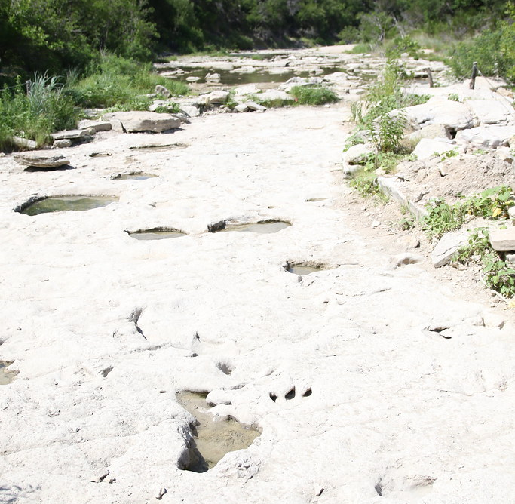
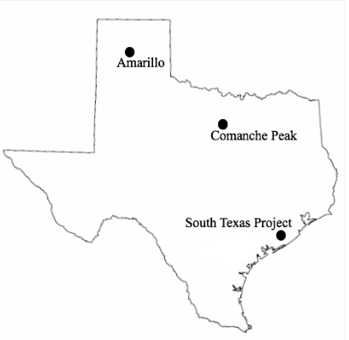
Emergency Response
Two nuclear power plants
Bay City
Glen Rose
Munitions plant
Amarillo
Waste Isolation Pilot Plant Route
Dinosaur State Park: Long ago, dinosaurs left footprints in the mud at the edge of an ancient ocean. Today, you can walk in their tracks in the bed of the Paluxy River. This long trip to the past is just a short drive from Fort Worth.
This Photo by Unknown Author is licensed under CC BY
Notes:
Home of the deadliest US natural disaster 1900 Galveston Hurricane > 8,000 people killed

Slide 17
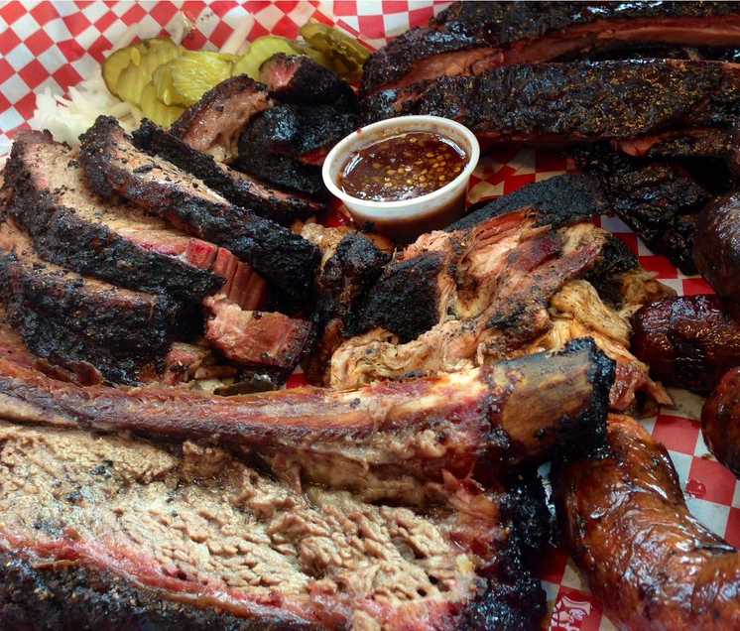
COVID Response
18 staff supported the COVID response full time
Deputy Ops Chief
Contact Tracing & Interviews
Assistance Requests
Call Center
Alternate Care Sites
6 weeks to 12 months
This Photo by Unknown Author is licensed under CC BY-SA
Texas Barbecue refers to methods of preparation for barbecue unique to Texan cuisine. Beef brisket, pork ribs, and sausage are among the most commonly known dishes. The term can also include side dishes that are traditionally served alongside the smoked meats.
Notes:
Chili is the official state dish

Slide 18
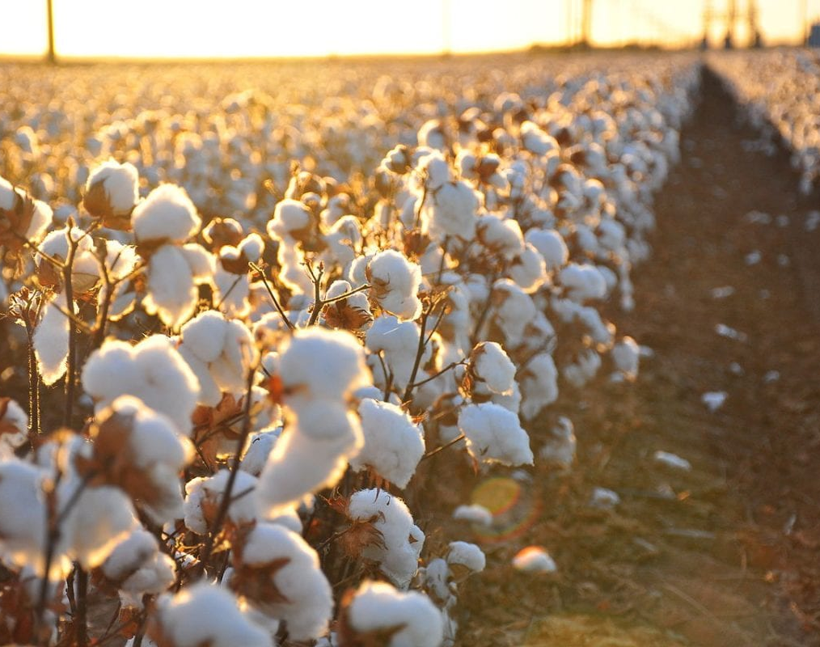
COVID Adjustments
Licensing
Adjusted to working remotely
Started digitizing files
SharePoint
This Photo by Unknown Author is licensed under CC BY-SA-NC
Texas leads the U.S. in cotton production, and is the state’s leading cash crop, supporting an economic impact of over $5 billion. Texas annually produces about 25% of the entire U.S. crop and plants about 6 million acres!

Slide 19
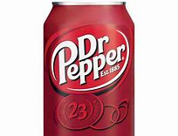
COVID Adjustments
Dr Pepper is a carbonated soft drink. It was created in the 1880s by pharmacist Charles Alderton in Waco, Texas, and first served around 1885.
Inspections
Stopped on-site inspections March 16, 2020
Resumed full on-site inspections June 1, 2020
Conducted a few pre-licensing inspections to keep facilities running
Conducted a few on-site investigations for health and safety
Completed backlog by end of 2020
Whataburger is an American regional fast food restaurant chain, headquartered and based in San Antonio, Texas, that specializes in hamburgers. The company, founded by Harmon Dobson and Paul Burton, opened its first restaurant in Corpus Christi, Texas, in 1950.
Notes:
Margaritas were also invented in 1971 – inspired by the slurpee machine

Slide 20
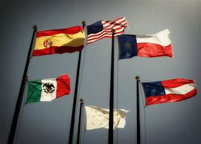
COVID Lessons
We don’t need offices
Division moved 314 people into space for 75
Radiation
82 staff share 20 offices/cubicles
Central Office doesn’t have to be in the Austin
Most positions can work anywhere in the state
The flags of six nations have flown over Texas. They are:
Spain (1519-1685; 1690-1821)
France (1685-1690)
Mexico (1821-1836)
Republic of Texas (1836-1845)
Confederate States of America (1861-1865)
United States of America (1845-1861; 1865- )
Notes:
Attract more diverse group – appealing to retirees that don’t want to move locations – cost of living

Slide 21
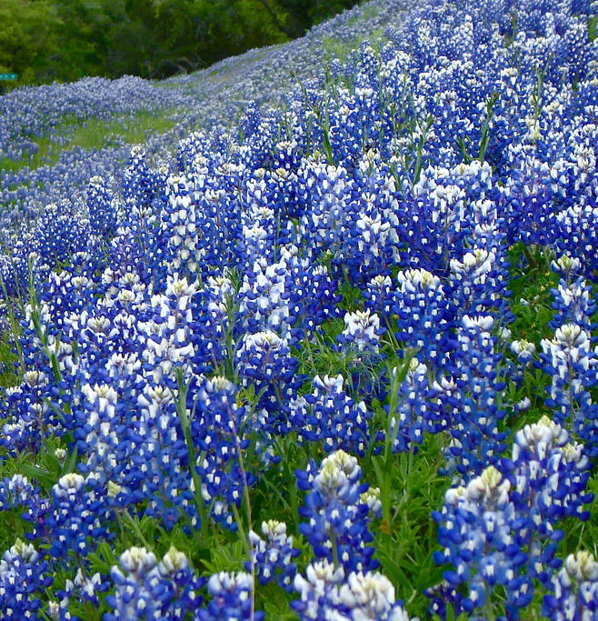
Cobalt Magnet ‘22
Sponsored by DOE
Invested $1.4 million
Over 18 months to plan
30 Organizations
DSHS – 38 participants
First TX exercise with ROSS participation
First integration with DOE and state sample prep
DSHS/DOE field teams integrated
Recorded 630 field surveys
Collected 63 samples
Drove over 500 miles in 5 days
100’s of lessons learned
This Photo by Unknown Author is licensed under CC BY-NC-ND
Bluebonnets: The State Flower of Texas

Slide 22
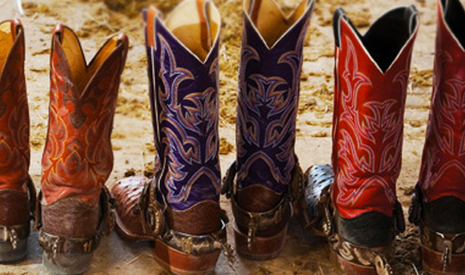
Enjoy your stay
we’ll
See
you
on the dance floor!
Official footwear of Texas

