Slide 1
General License Modernization – Where Are We Now? Duncan White US Nuclear Regulatory Commission Angela Leek State of Iowa August 16, 2022

Slide 2
Agenda
Current GL Activities at the NRC – Duncan
CRCPD/OAS Task Force – Angela

Slide 3
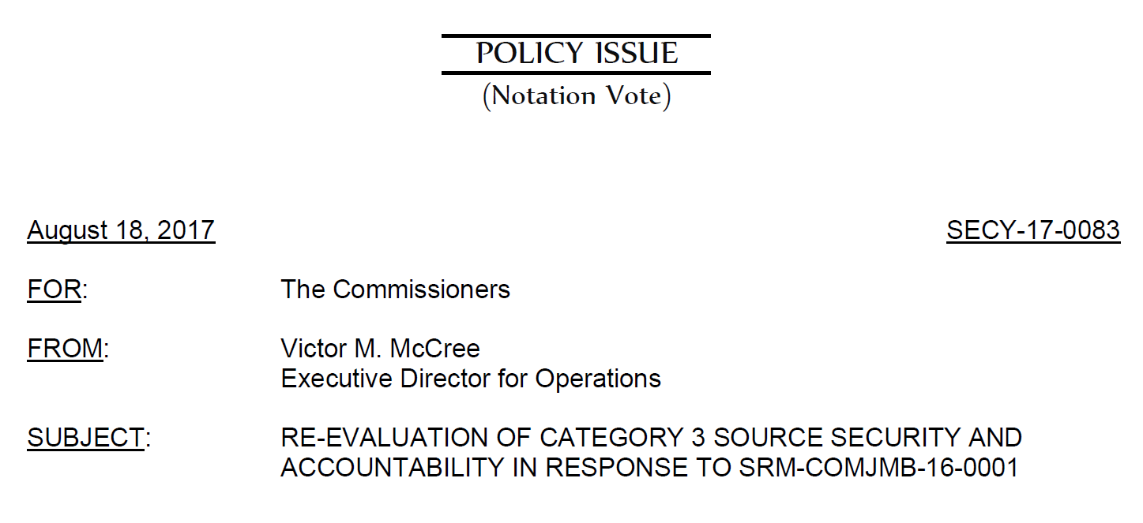
Brief History
SECY-17-0083
General License Working Group
General License Modernization Working Group

Slide 4
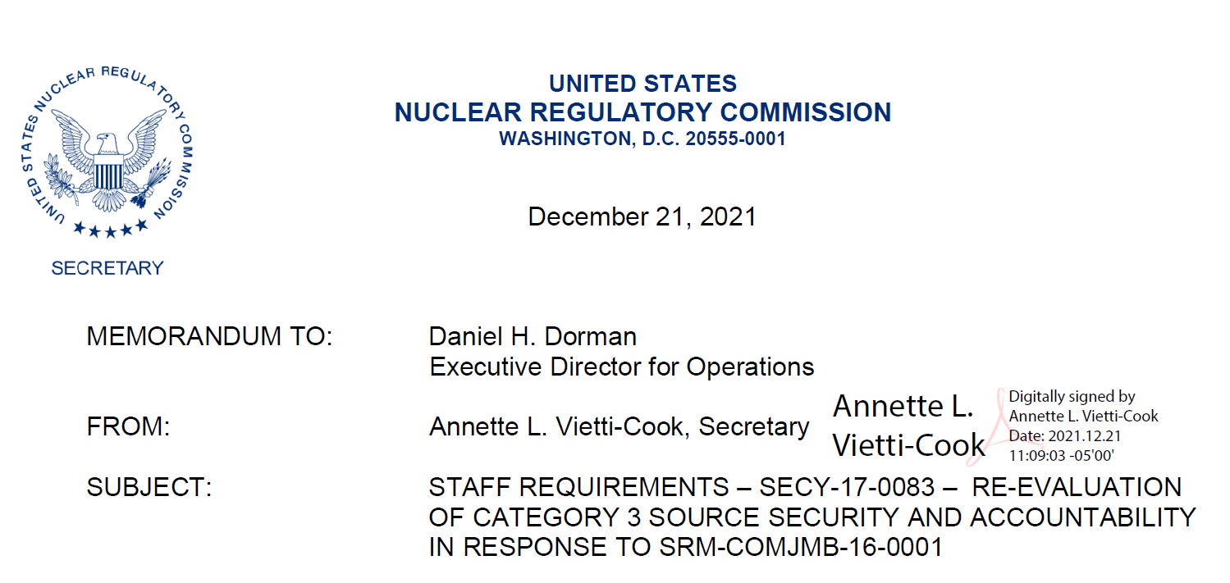
SRM-SECY-17-0083
“Within six months of the final Staff Requirements Memorandum, the staff should provide to the Commission a notation vote paper with the staff’s evaluation and recommendations developed by the General License Program Re-Evaluation Working Group and the General License Program Modernization Working Group.”

Slide 6
Options in SECY-22-0065
Maintain Current Regulatory Framework
Modifying Annual Registration Requirements
Requiring a Simplified Specific Licenses
Combination of Options 2 and 3
Increase Communications with End Users of Generally Licensed Devices

Slide 7
Staff Recommended Option
Option 1: Maintain Status Quo
Vigorous review process
Risk informed approach to accountability
No significant risk of exposure to lost unregistered devices
Costs associated with rulemaking and other changes could be significant

Slide 8
Next Steps
Alignment with rulemaking for license verification of transfers of Category 3 quantities
Commission Decision on SECY-22-0065

Slide 9
General Licensing Program Review,
The Story Continues..
Recommend Best Practices for States
and potential rulemaking for NRC
OAS/CRCPD Workgroup formation
GLMWG Memo Finalized

Slide 10
CRCPD Task Force Established
G-75 General Licensing Program Guideline Development Task Force
Morgan Bullock – chair (leaving state gov’t) – discussions underway with possible new chair
Tomas Herrera – NRC representative
WE NEED MEMBERS!

Slide 11
G-75 Task Force Charges
Review and evaluate recommendations and conclusions of the OAS/NRC General Licensing working group as a basis for developing general license program guidelines.
Evaluate and identify how the National Materials Program can be more consistent with respect to the general licensing programs.
Evaluate licensing practices for general and specific devices to provide clear and consistent licensing practices for state programs to follow.

Slide 12
G-75 Task Force Charges
Develop a survey for CRCPD and Agreement State programs to help identify “best practices”, unique regulations and/or desired regulations.
Use survey results and previous working group conclusions and recommendations to develop a “Best Practices Program Guidelines” for general licensing that provides structure and guidance for agreement states to follow to implement an adequate GL program.
Determine if Suggested State Regulations or NRC Petition for Rulemaking are appropriate to support the GL best practices program guidelines.

Slide 13
We already know some things…..
Review of GLMWG Activities
General License Program Modernization Working Group (GLMWG) evaluated the General License (GL) program using the NRC requirements in 10 CFR 31.5 as a baseline
Goal is to make the GL program more risk informed and “right-sized”

Slide 14
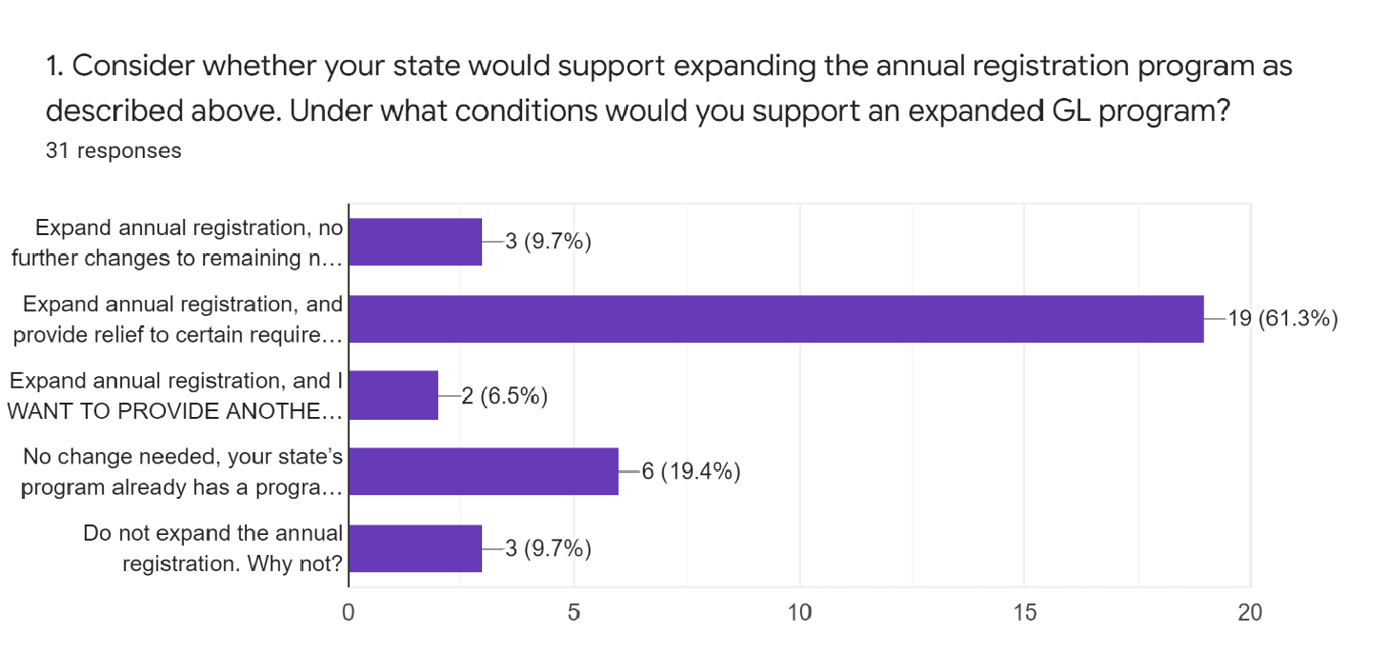
GLMWG Survey Results

Slide 15
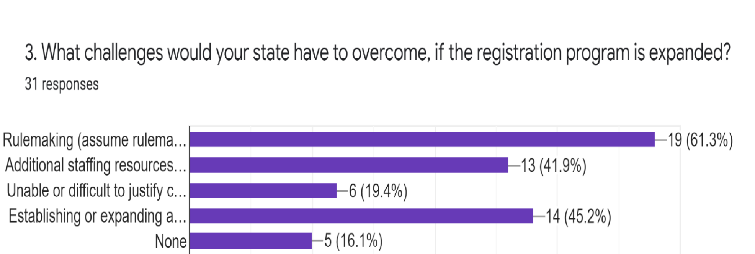
GLMWG Survey Results

Slide 16
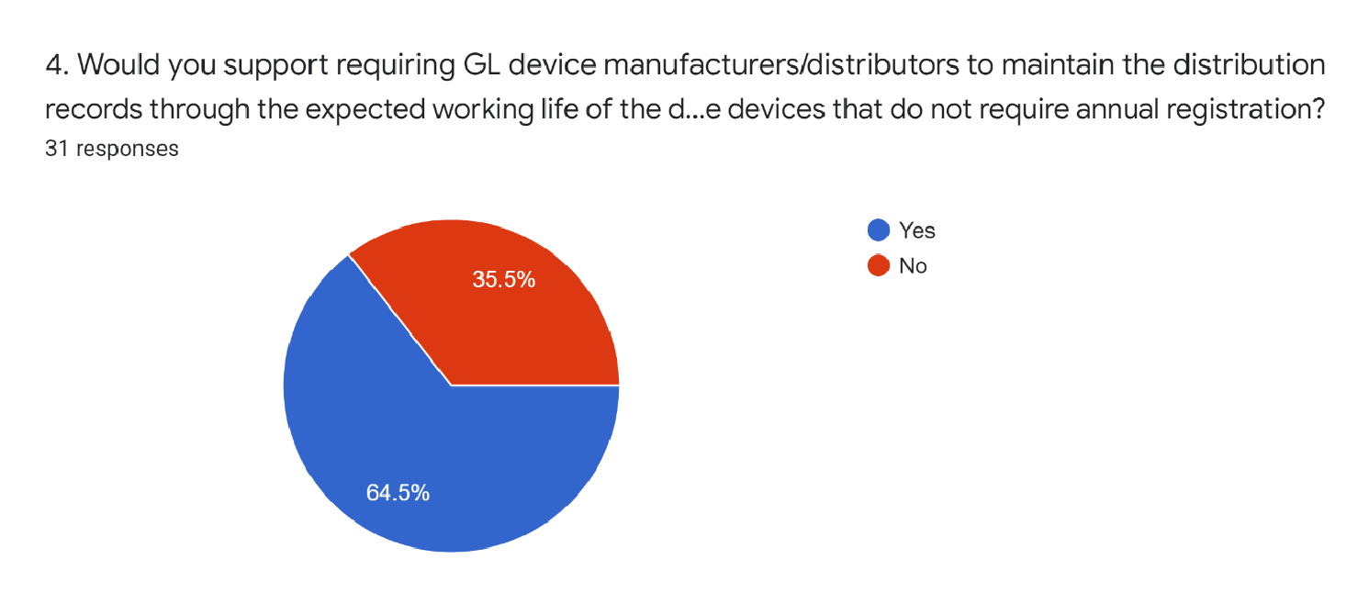
GLMWG Survey Results

Slide 17
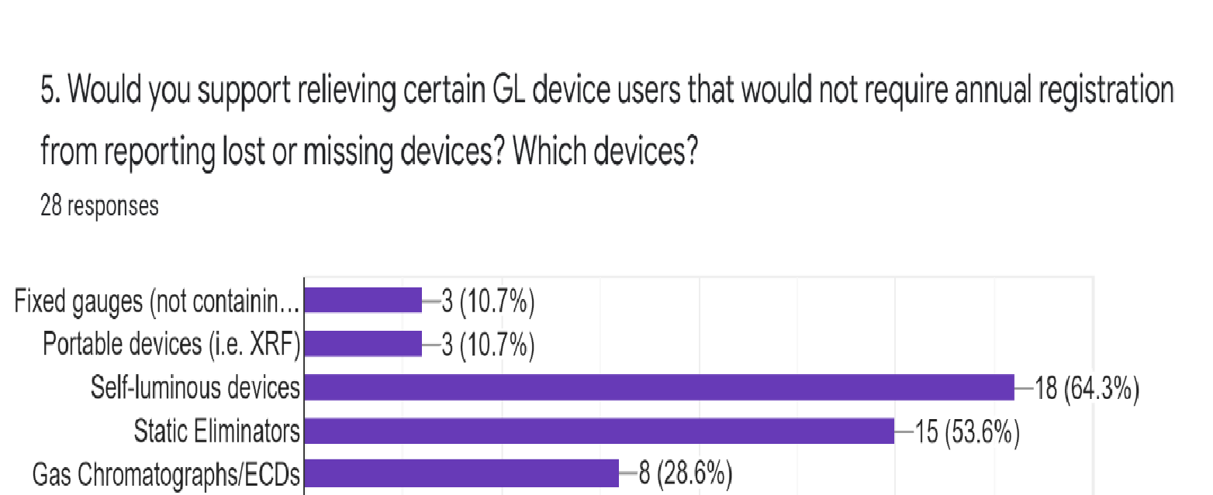
GLMWG Survey Results

Slide 18
Task Force Goals
Reduce staff efforts in tracking large numbers of relatively low hazard devices while allowing for more oversight and communication for higher activity and/or mobile sources that pose more risk for improper use or disposal.
Many of these proposed items and alignment efforts are possible with minimal regulatory changes. Rule changes would be required for more complex options, such as reclassifying certain GL devices as exempt.

Slide 19
Questions?

