Slide 1

GL Devices in
Recycling Streams from Food/Beverage Processors
Stephen James
Health Physics Supervisor
Ohio Department of Health
Organization of Agreement States Annual Meeting
August 18, 2022

Slide 2
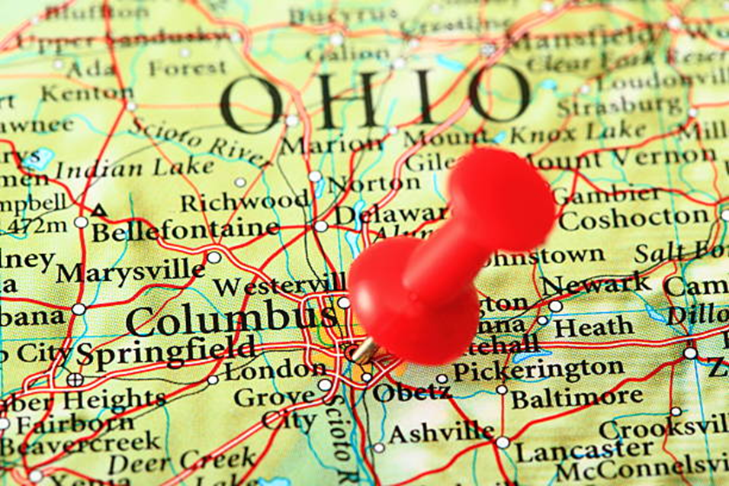


Slide 3

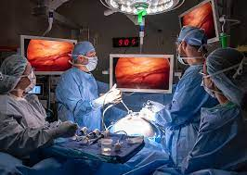
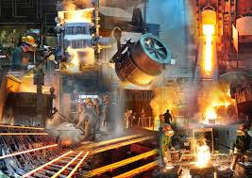

Slide 4
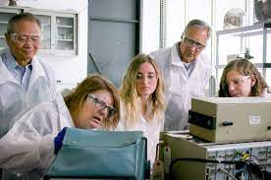
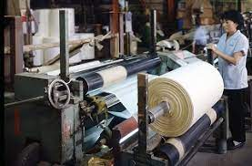
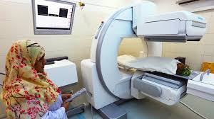

Slide 5
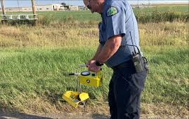
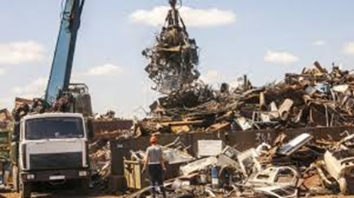
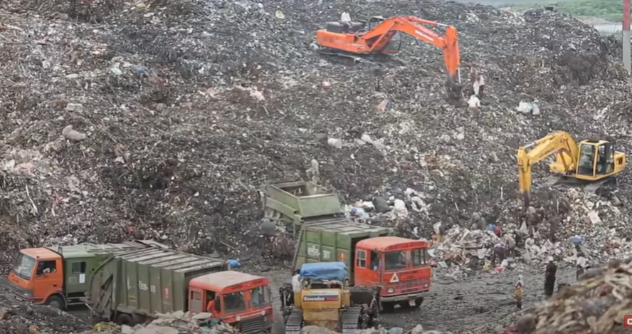

Slide 6

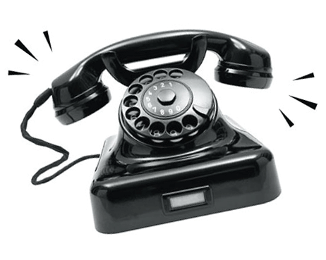

Slide 7

RADMAT

Slide 8
GL Devices in
Recycling Streams from Food/Beverage Processors
Stephen James
Health Physics Supervisor
Ohio Department of Health
Organization of Agreement States Annual Meeting
August 18, 2022

Slide 9
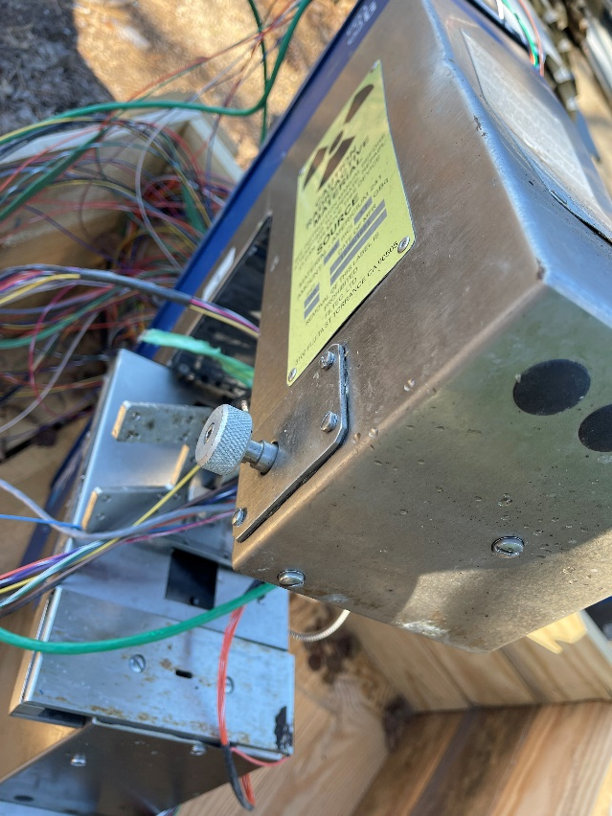
The Initial Incident
On November 19, 2021, a scrap metal facility in western Ohio informed the Ohio Department of Health (ODH) they had discovered two devices containing radioactive material at their facility.

Slide 10
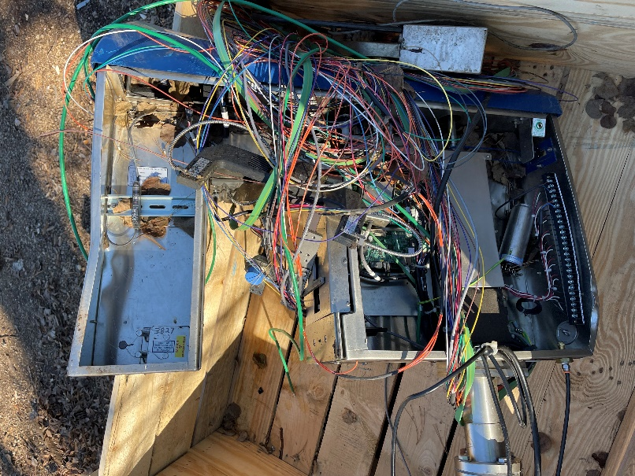
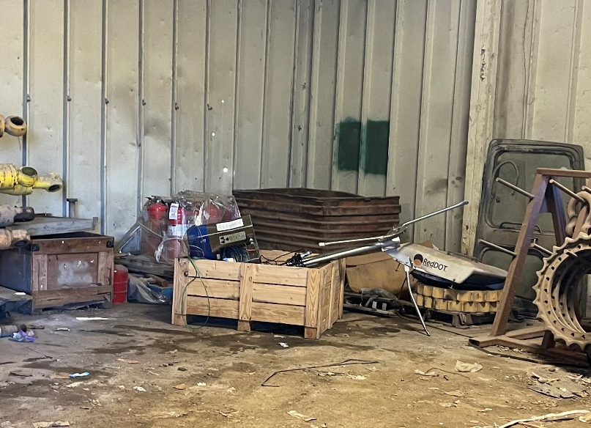
An ODH inspector responded to the scrapyard, surveyed the two devices, and found dose rates of 30 µR/hr.
Swabs taken showed no contamination present.
The gauges were placed in a secure location pending proper disposal.

Slide 11
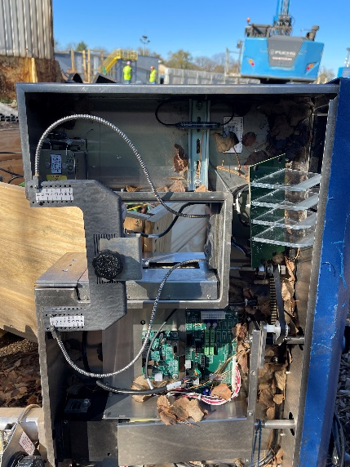
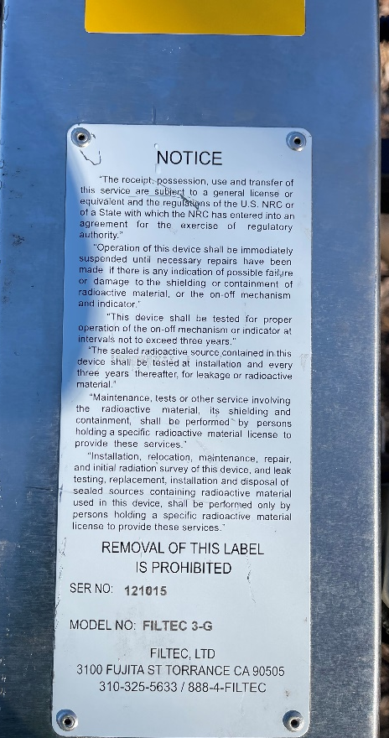

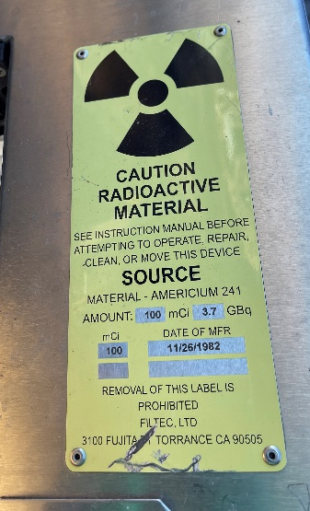
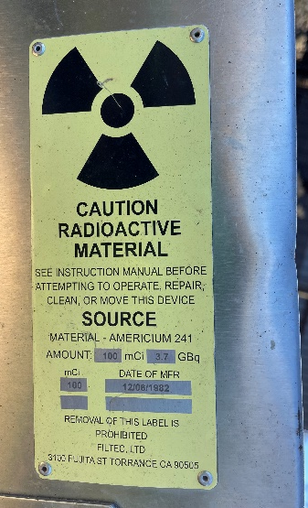
Further investigation identified the devices as FILTEC 3-G gauges, each containing a 100 mCi
Am-241 sealed source.

Slide 12

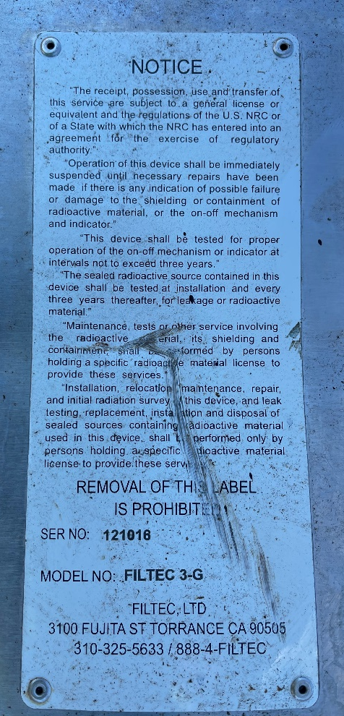
ODH was able to identify the serial numbers of the two devices and contacted the manufacturer, FILTEC in Torrance, California, to see if they could help us identify the owner.

Slide 13
The manufacturer identified the “ACME” Dairy as the end user; however:
  The units were originally sold to a contractor
  as part of the equipment for a new process
  line, which was installed at the dairy.
  When the product line was later shut down,
  the decommissioning contractor took all the
  equipment, including the two FILTEC devices,
  unaware they contained radioactive materials.
Notes:
We were unable to determine if the contractor passed along the information regarding the requirements for the GL devices they installed.

Slide 14
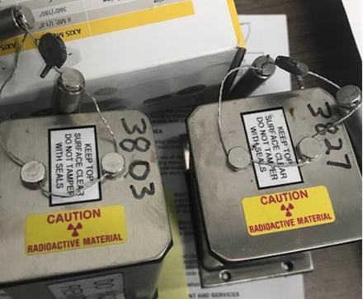
When contacted by ODH, “ACME” Dairy acknowledged their responsibility as owner of the devices, accepted responsibility for their disposal, and worked with ODH and the manufacturer to get the devices properly packaged and shipped.

Slide 15

An ODH inspector later visited the
“ACME” Dairy to review the incident
with their staff and tour the facility.
Two additional GL devices requiring registration were identified during the site visit.

Slide 16
NEXT STEPS
Ohio has numerous food and beverage processing facilities with GL devices registered under the requirements of Ohio Administrative Code (OAC) 3701:1-46-05.
How do we make sure there aren’t any more “ACME” Dairies out there?

Slide 17

We reached out to our counterparts
at the Ohio Department of Agriculture (ODA).
This is the state agency that regulates food production and manufacturing in Ohio.

Slide 18

ODA provided us with an initial list of 2,666 facilities licensed for food and/or beverage production in Ohio.

Slide 19




Breweries/Meaderies – 128
Wineries/Distilleries – 78
Dairies/Creameries – 19
Water/Ice Producers – 18
Cider/Syrup Producers – 18
Miscellaneous Beverages – 40
Miscellaneous Food Producers – 92
Other Miscellaneous – 28
Notes:
ODH pared the list down to 421 companies, based on the types of facilities already registered in Ohio:

Slide 20
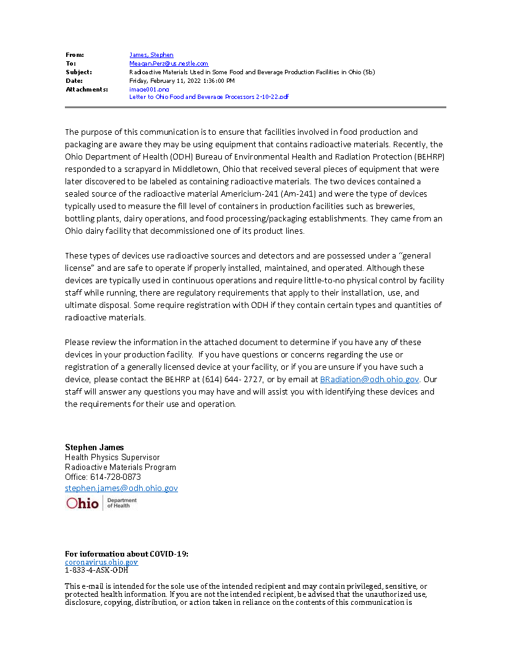
We drafted a letter to these companies with a brief explanation of what had transpired, the fact that they may have processing equipment using radioactive materials, and what the requirements are for their proper use and disposal.

Slide 21
We also included a few pictures of what these devices might look like.

Slide 22

A letter was also prepared for scrapyards and metal processing facilities in Ohio, reminding them to be aware of the potential for radioactive materials to show up at their facility, and what the requirements are when something radioactive is discovered.
That letter was distributed by the Ohio Department of Public Safety, which has a program that works with scrap facilities to monitor the theft and brokering of valuable metals.

Slide 23
Lessons Learned
1. The need for periodic outreach to scrapyards and
metal processing facilities regarding notification requirements and Department of Transportation exemptions.
2. Closer review needed of quarterly reports sent by GL manufacturers.
3. Outreach to the regulated community and other
stakeholders is usually appreciated, particularly when it includes informational materials.

Slide 24

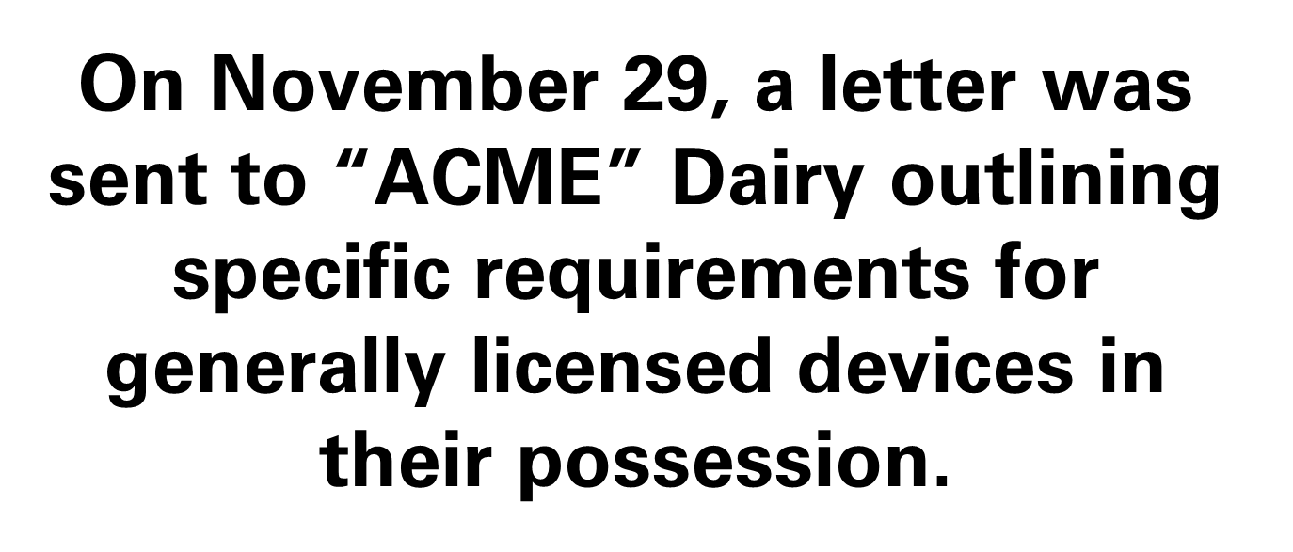
In a moment, the results
of that communication.

Slide 25





Slide 26


The “ACME” Dairy
is now in full compliance with all general licensing requirements.
Contact Information
Stephen James
614-728-0873
Stephen.James@odh.ohio.gov

